Slide 1

Department of ECE
ANALOG ELECTRONIC CIRCUIT DESIGN 22EC2104A
CO-2
Session-7 Small signal models of FET

Slide 2





AIM OF THE SESSION
To familiarize students with the small signal models of FET
INSTRUCTIONAL OBJECTIVES
This Session is designed to:
Give introduction FET small signal analysis
To analysis operation of FET amplifiers
LEARNING OUTCOMES
At the end of this session, you should be able to:
1. Describe the working of FET amplifier circuits.
2. Demonstrate the operation of FET amplifiers.

Slide 3
INTRODUCTION
The small-signal model of a Field-Effect Transistor (FET) is a simplified representation used to analyze its behavior under small variations in input signals.
It is based on the assumption that the transistor operates in a linear region around a bias point.
The small-signal model consists of a voltage-controlled current source, representing the transconductance, and a resistor, representing the output impedance.
By using this model, the FET can be treated as a linear device, enabling analysis of its amplification and signal processing capabilities.
The small-signal model is commonly employed in designing and optimizing FET-based circuits for applications such as amplifiers, filters, and oscillators.

Slide 4
FET small signal model
In FET circuit, the Vgs is the input signal applied between gate and source terminal, and we know that the change in drain current is linearly proportional to Vgs.
In this model, if you consider the effect of channel and modulation, then there will also be an output resistance (r0).
If it is for a long length channel, then, as read in the Early Voltage section in the MOS transistor for a long length channel, the curve slope is almost constant in the saturation region, λ is very low, sometimes considered 0.
Therefore, under the small-signal approximation, the MOS transistor can be replaced by the small-signal model

Slide 5
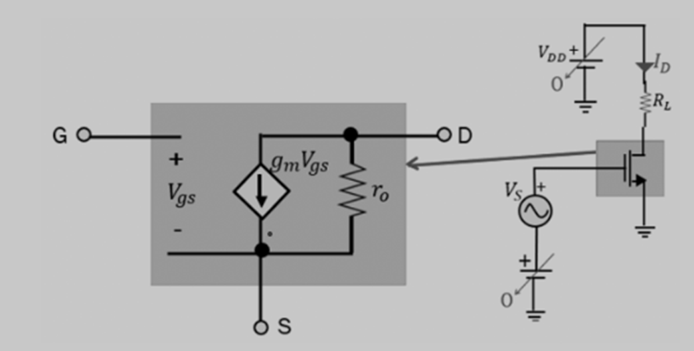
Cont..

Slide 6
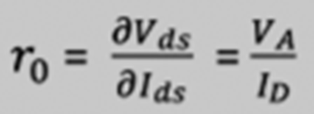
Cont…
In the small-signal model, there is an output resistance r0 and the current source is g_{m}V_{gs}, so if we can find the Transconductance (gm), we can find the value of current in this circuit. Output resistance r0 is the fluctuation of drain-source voltage to current.
For the long channel transistor, the V_{A} (early voltage) is high, and as per the equation, r0 is directly proportional to length; therefore, r0 is high for the long channel transistor.
Here, I_{D} is the current bias.

Slide 7
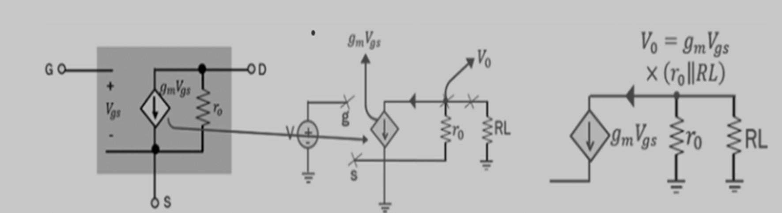
Cont…
While doing the AC analysis, all the DC voltage in the circuit is assumed 0 and vice versa. The analysis for DC and AC is done separately.
When we talk about gain, it is AC gain, and DC is just to set the operation point.
When the small circuit model is replaced for the transistor, we get the below circuit arrangement:

Slide 8
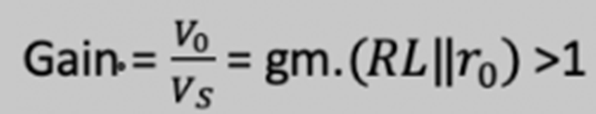
Cont..
AC analysis for the given circuit considering DC is 0 & V_{DD} is grounded. V_{S} in a small signal model is placed between gate and source terminal.
When input signal V_{S} is very low, the MOS transistor can be replaced by the small-signal model.
The flow of current is clockwise and is gmV_{GS}, and V₀ is connected to load resistance R_{L}. R₀ and R_{L} are in a parallel arrangement.
Therefore, gain here will be gmV_{GS}. (R_{L}||r₀) and this value is more than 1, and this shows that the output voltage will be amplified.

Slide 9

SUMMARY
The small-signal model of FETs is a simplified representation used to analyze their behavior under small variations in input signals.
It assumes that the transistor operates in a linear region around a bias point.
The small-signal model consists of a voltage-controlled current source, representing the transconductance, and a resistor, representing the output impedance.
By using this model, FETs can be treated as linear devices, enabling analysis of their amplification and signal processing capabilities.
The small-signal model is commonly employed in designing and optimizing FET-based circuits for applications such as amplifiers, filters, and oscillators.
It provides a convenient framework for understanding and predicting the small-signal behavior of FETs in electronic circuits.

Slide 10
SELF-ASSESSMENT QUESTIONS
1.The small signal model of a MOSFET assumes that the gate-to-source voltage is:
a) Constant
b) Variable
c) Zero
d) Infinite
2.The small signal model of a MOSFET assumes that the gate-to-source voltage is small enough to:
a) Neglect the threshold voltage
b) Neglect the channel length modulation
c) Neglect the body effect
d) Neglect the output resistance

Slide 11
TERMINAL QUESTIONS
1. Draw and explain small signal model of FET
2. Explain the concept of the small-signal model of FETs in detail and discuss its components and applications.

Slide 12
REFERENCES FOR FURTHER LEARNING OF THE SESSION
Reference Books:
1. Jacob Millman - “Electronic Devices and Circuits”, 4th Edition, McGraw Hill Education (2015)
2. D Roy Choudhury and Shail B. Jain – “Linear Integrated Circuits”, 4th Edition, New Age International Pvt.Ltd. (2017)
3. David A. Bell - “Electronic Devices and Circuits”, 5th Edition, Oxford University Press (2008)
Sites and Web links:
https://www.learnelectronicswithme.com/2020/07/what-is-jfet-construction-and-working.html
https://electronicspost.com/explain-the-construction-and-working-of-a-jfet-what-is-the-difference-between-a-jfet-and-a-bjt/
https://electronicsdesk.com/junction-field-effect-transistor.html

Slide 13
THANK YOU
Team – ANALOG ELECTRONIC DEVICES AND CIRCUITS

